Slide 1

Week 5 - Lecture
ACN – IP Addressing and Subnetting
enda.stafford@ncirl.ie

Slide 2
Agenda – IP Addressing and Subnetting
Basics of IP Addressing
Subnetting
Classless Inter-Domain Routing (CIDR Notation)

Slide 3

Basics of IP Addressing

Slide 4
Why IP addresses
A MAC address has no structure, so it tells a switch the identity (who) of the destination interface but not its location (where).
With just MAC addresses, switches would have to resort to broadcast the first time they encounter a new address.
Switch forwarding table sizes would be of the order of the total number of MAC addresses.

Slide 5
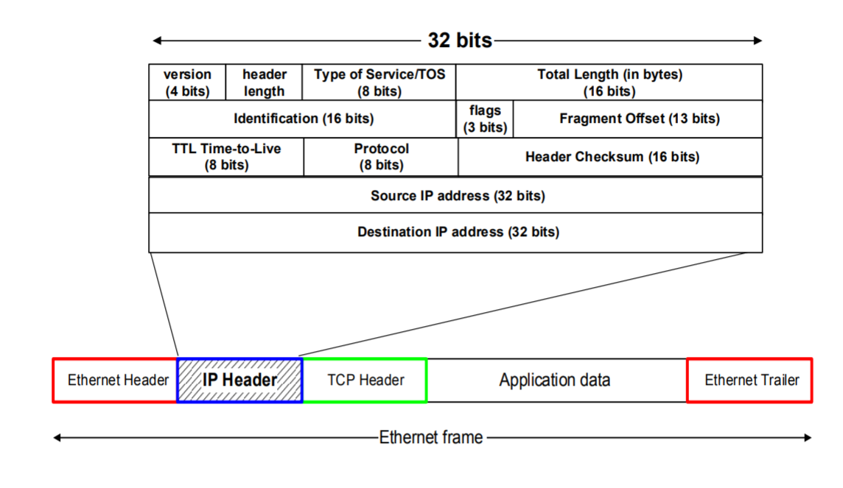
IP addresses in packets
Source and destination in Network Layer

Slide 6
What is an IP address
An IP address is a unique global address for a network interface
Exceptions:
Dynamically assigned IP addresses (DHCP)
IP addresses in private networks (NAT)
An IP address:
is a 32 bit long identifier
encodes a network number (network prefix) and a host number

Slide 7
Network Prefix and Host number
The network prefix identifies a network, and the host number identifies a specific host (actually, interface on the network).
How do we know how long the network prefix is?
The network prefix is indicated by a netmask.
E.g. 255.255.255.0
Network Prefix
Host Number

Slide 8
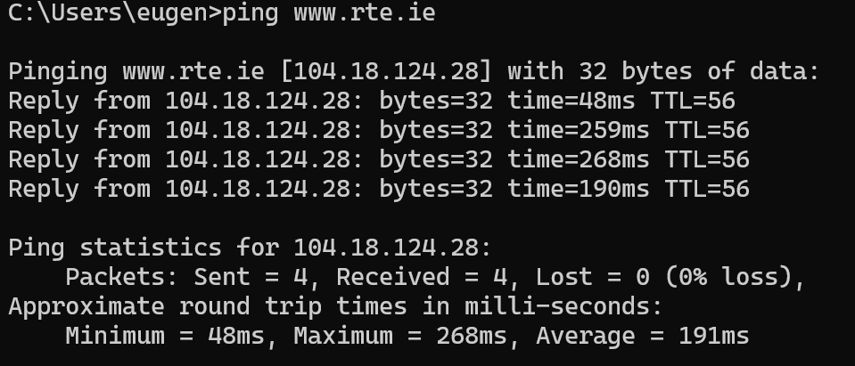

Slide 9
Network Prefix and Host number
Example: www.rte.ie
Network address is: 104.0.0.0 (or 104)
Host number is: 18.124.28
Netmask is: 255.0.0.0
Prefix or CIDR notation: 104.18.124.28/8
» Network prefix is 8 bits long
104
18.124.28

Slide 10
C:\Users\User>ping www.ncirl.ie
Pinging www.ncirl.ie [78.153.205.252] with 32 bytes of data:
Reply from 78.153.205.252: bytes=32 time=11ms TTL=121
Reply from 78.153.205.252: bytes=32 time=11ms TTL=121
Reply from 78.153.205.252: bytes=32 time=10ms TTL=121
Reply from 78.153.205.252: bytes=32 time=12ms TTL=121
Ping statistics for 78.153.205.252:
Packets: Sent = 4, Received = 4, Lost = 0 (0% loss),
Approximate round trip times in milli-seconds:
Minimum = 10ms, Maximum = 12ms, Average = 11ms

Slide 11
C:\Users\User>ping www.independent.ie
Pinging www.independent.ie [2606:4700:4400::6812:20b4] with 32 bytes of data:
Reply from 2606:4700:4400::6812:20b4: time=10ms
Reply from 2606:4700:4400::6812:20b4: time=10ms
Reply from 2606:4700:4400::6812:20b4: time=10ms
Reply from 2606:4700:4400::6812:20b4: time=10ms
Ping statistics for 2606:4700:4400::6812:20b4:
Packets: Sent = 4, Received = 4, Lost = 0 (0% loss),
Approximate round trip times in milli-seconds:
Minimum = 10ms, Maximum = 10ms, Average = 10ms

Slide 12
Special IP addresses
Reserved or (by convention) special addresses:
Loopback interfaces –
All addresses 127.0.0.1-127.255.255.255 are reserved for loopback interfaces
Most systems use 127.0.0.1 as loopback address
loopback interface is associated with name “localhost”
IP address of a network
Host number is set to all zeros, e.g., 128.143.0.0
Broadcast address –
Host number is all ones, e.g., 128.143.255.255
Broadcast goes to all hosts on the network
Often ignored due to security concerns

Slide 13
Special IP addresses
Test / Experimental addresses
Certain address ranges are reserved for “experimental use”. Packets should get dropped if they contain this destination address (see RFC 1918):
10.0.0.0 - 10.255.255.255
172.16.0.0 - 172.31.255.255
192.168.0.0 - 192.168.255.255
Convention (but not a reserved address)
Default gateway has host number set to ‘1’, e.g., e.g., 192.0.1.1

Slide 14
CIDR Notation
Classless
Interdomain
Routing

Slide 15
CIDR Notation
CIDR notation of an IP address:
192.0.2.0/18
"18" is the network prefix length. It states that the first 18 bits are the network prefix of the address (and 14 (32 - 18) bits are available for specific host addresses)
CIDR notation can replace the use of subnetmasks (but is more general)
IP address 128.143.137.144 and subnetmask 255.255.255.0 becomes 128.143.137.144/24
CIDR notation allows to drop trailing zeros of network addresses: 192.0.2.0/18 can be written as 192.0.2/18

Slide 16
CIDR Address blocks
CIDR notation can nicely express blocks of addresses
Blocks are used when allocating IP addresses for a company and for routing tables (route aggregation)
CIDR Block Prefix # - of Host Addresses
/27 32 - (2^5)
/26 64
/25 128
/24 256
/23 512
/22 1,024
/21 2,048
/20 4,096
/19 8,192
/18 16,384
/17 32,768
/16 65,536
/15 131,072
/14 262,144
/13 524,288 - (2^19)
Notes:
Backbone ISPs obtain large block of IP addresses space and then reallocate portions of their address blocks to their customers.
Example:
Assume that an ISP owns the address block 206.0.64.0/18, which represents 16,384 (2¹⁴) IP addresses
Suppose a client requires 800 host addresses
With classful addresses: need to assign a class B address (and waste ~64,700 addresses) or four individual Class Cs (and introducing 4 new routes into the global Internet routing tables)
With CIDR: Assign a /22 block, e.g., 206.0.68.0/22, and allocated a block of 1,024 (2¹⁰) IP addresses

Slide 17
Subnetting

Slide 18
Subnetting
Problem: Organizations have multiple networks which are independently managed
Solution 1: Allocate a separate network address for each network
Difficult to manage
From the outside of the organization, each network must be addressable.
Solution 2: Add another level of hierarchy to the IP addressing structure
→ Subnetting

Slide 19
Subnetting
University Network
Computing
Business
Each part of the organization is allocated a range of IP addresses (subnets or subnetworks)
Addresses in each subnet can be administered locally
Library
University Network
128.143.0.0/16
128.143.71.0/24
128.143.136.0/24
Computing
128.143.56.0/24
Business
Library
128.143.121.0/24

Slide 20
Subnetting basics
Split the host number portion of an IP address into a subnet number and a (smaller) host number.
Result is a 3-layer hierarchy
Extended network prefix (subnet mask)
Subnets can then be freely assigned within the organization
Internally, subnets are treated as separate networks
Subnet structure is not visible outside the organization
Network Prefix
Host number
Subnet Number
Host Number
Network Prefix

Slide 21
Example: Subnet mask
128.143.0.0/16 is the IP address of the network
128.143.137.0/24 is the IP address of the subnet
128.143.137.144 is the IP address of the host
255.255.255.0 is the subnet mask of the host
Use of subnetting or length of the subnetmask is decided by the network administrator
Consistency of subnetmasks is responsibility of administrator

Slide 22
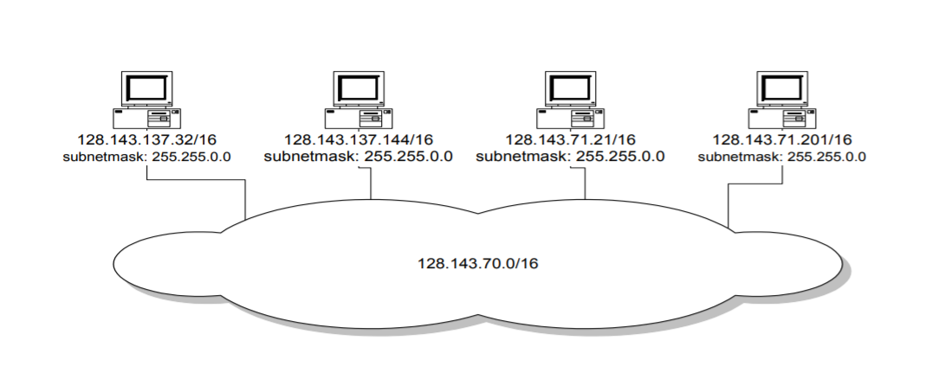
No subnetting
All hosts think that the other hosts are on the same network

Slide 23
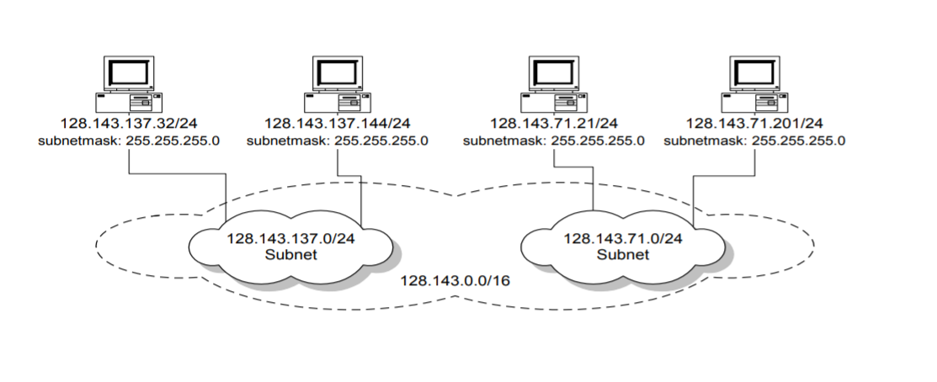
With Subnetting
Hosts with same extended network prefix belong to the same network

Slide 24
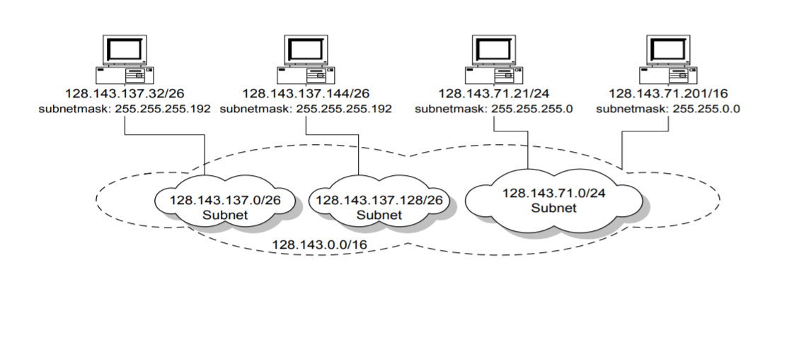
With further subnetting
Different subnet masks lead to different views of the size of the scope of the network

Slide 25
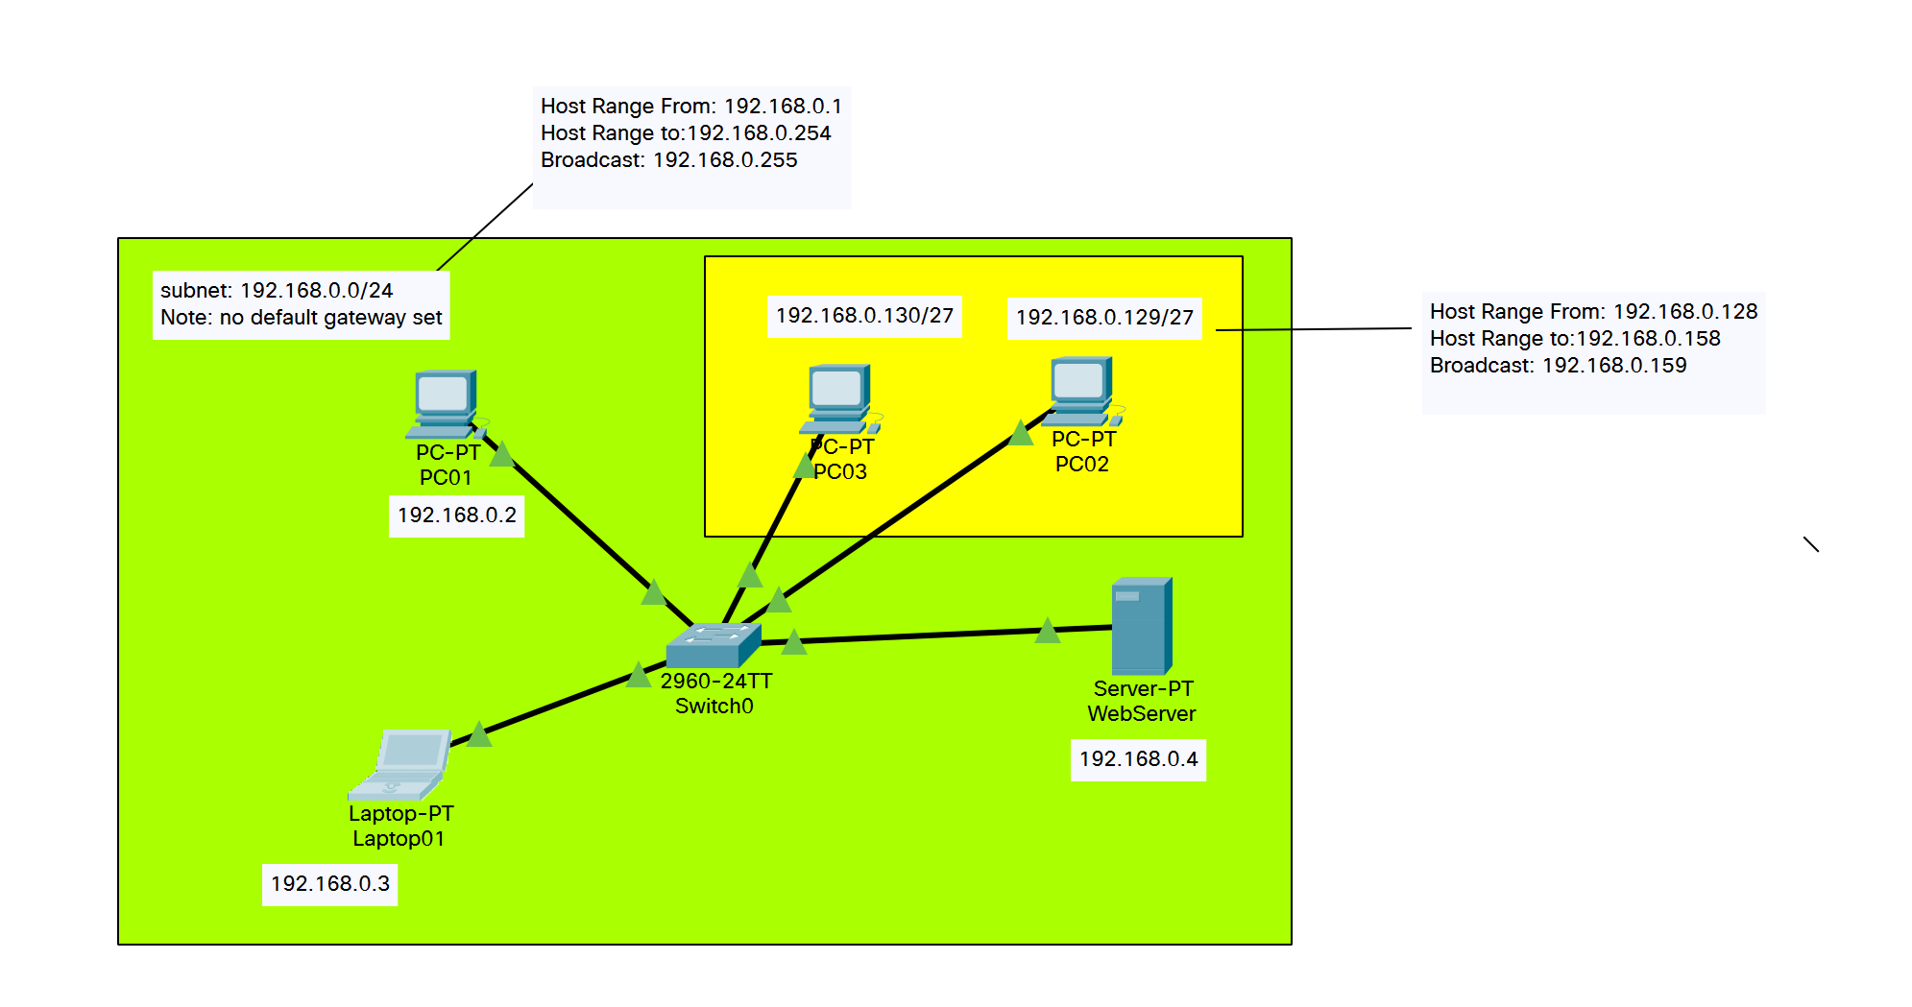
Example from last weeks lab

Slide 26
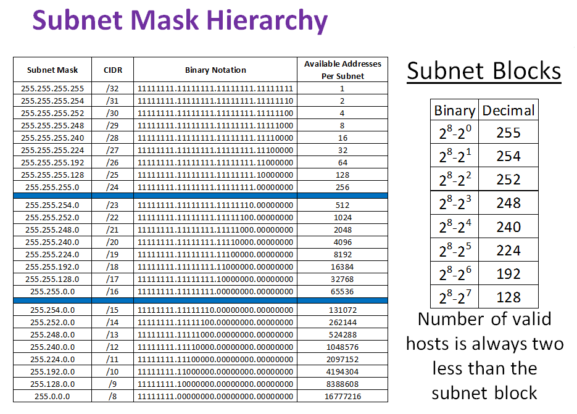
Subnet mask table

Slide 27
Advantages of Subnetting
With subnetting, IP addresses use a 3-layer hierarchy:
» Network
» Subnet
» Host
Reduces router complexity. Since external routers do not know about subnetting, the complexity of routing tables at external routers is reduced.
Note: Length of the subnet mask need not be identical at all subnetworks.

Slide 28
Exercise
Given a Subnet of 192.168.0.0/16 – Define 4 subnets such that the below criteria is met.
Customer A requires 900 hosts
Customer B requires 31,867 hosts
Customer C requires 28 hosts
Custer D requires 2376 hosts

Slide 29
Sample Solution
Network Address | Broadcast Address | Direction | Name
192.168.0.0/16 | 192.168.255.255 | User-Facing | Parent Subnet
192.168.0.0/17 | 192.168.127.255 | User-Facing | Customer B
192.168.0.0/22 | 192.168.3.255 | User-Facing | Customer A
192.168.128.0/20 | 192.168.143.255 | User-Facing | Customer D
192.168.192.0/24 | 192.168.192.255 | User-Facing | Customer C

